Slide 1
CS2310 Computer Programming
LT3: Basic Syntax – Operators and basic I/O
Computer Science, City University of Hong Kong
Semester B 2021-22

Slide 2
Operators and punctuators
An operator specifies an operation to be performed on some values
These values are called the operands of the operator
Some examples: +, -, *, /, %, ++, --,>>,<<
Some of these have meanings that depend on the context

Slide 3
Expressions
An expression is a combination of constants, variables, and function calls that evaluate to a result
Example:
x = 3.0*4.0;
y = 2.0 + x;
z = 5.0 + x/y - sqrt(x*3.0);
constants
variables
function call

Slide 4
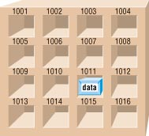
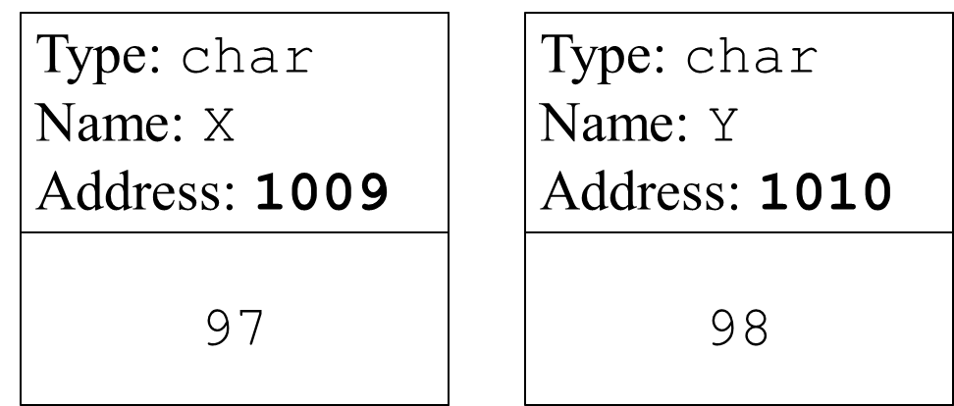
Assignment operator =
Generic form
variable = expression;
Variable
char x = ‘a’;

Slide 5
Assignment operator =
Generic form
variable = expression;
= is an assignment operator that is different from the mathematical equality (which is == in C++)
An expression itself has a value, e.g.,
a = (b = 2) + (c = 3);
An assignment statement has a value equal to the operand
In the example, the value of assignment statement “b=2” is 2 and “c = 3” is 3
Therefore, “a = …” is 5
a = 2 + 3;

Slide 6
Assignment operator =
Write-to a variable
After the write, the previous stored value in the variable no longer exists, and is replaced by the new value
97
Type: char
Name: X
Address: 1009
99
Type: char
Name: X
Address: 1009
Write ‘c’ to X
x = ‘c’;

Slide 7
Examples of assignment statements
/* Invalid: left hand side must be a variable */
x + 10 = y;
/*assignment to constant is not allowed*/
2=x;
/* valid but not easy to understand */
int a, b, c;
a = (b = 2) + (c = 3);
/* avoid complex expressions*/
int a, b, c;
b = 2;
c = 3;
a = b + c;

Slide 8

Increment & decrement operators
Increment and decrement operators: ++ and --
k++ and ++k are equivalent to k=k+1
k-- and --k are equivalent to k=k-1
Post-increment and post-decrement: k++ and k--
k’s value is altered AFTER the expression is evaluated
int k=0, j;
j=k++;
(equal to: 1. j=k; 2. k=k+1;)
Pre-increment and pre-decrement: ++k and --k
k’s value is altered BEFORE evaluating the expression
int k=0, j;
j=++k;
(equal to: 1. k=k+1; 2. j=k;)
k += 1

Slide 9
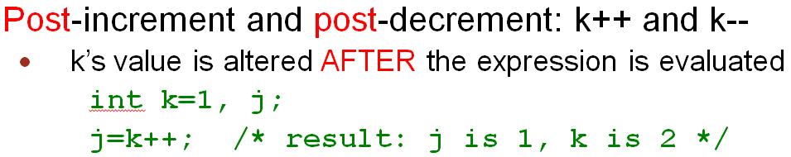
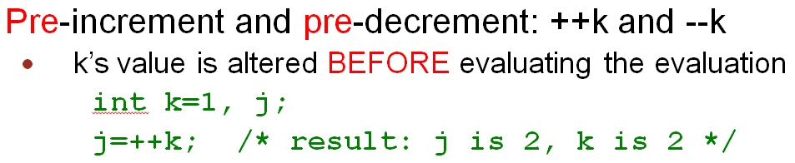
i=1+(k++);
k=0;
k=0;
i=1+(++k);
0
1
Use original value of k
Use updated value of k
i=1+0
=1
i=1+1
=2
Value of k will be 1 in both cases

Slide 10
What values are printed?
int k=0,i=0;
cout << "i= " << i << endl;
k=0;
i=1+(k++);
cout << "i= " << i << endl;
cout << "k= " << k << endl;
k=0;
i=1+(++k);
cout << "i= " << i << endl;
cout << "k= " << k << endl;
Output
i=0
i=1
k=1
i=2
k=1

Slide 11
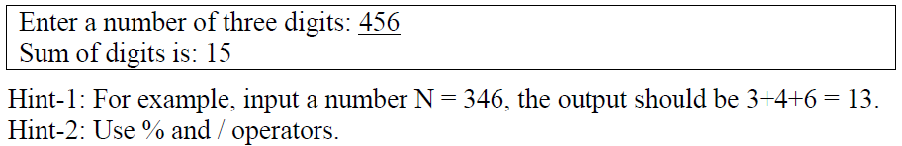
Division & modulus operators
Division operator: /
Return the quotient, e.g. 5 / 2 = 2
Modulus operator: %
Return the division remainder, e.g. 5 % 2 = 1
Example: write a program that reads a three-digit integer number and prints the sum of each digit

Slide 12
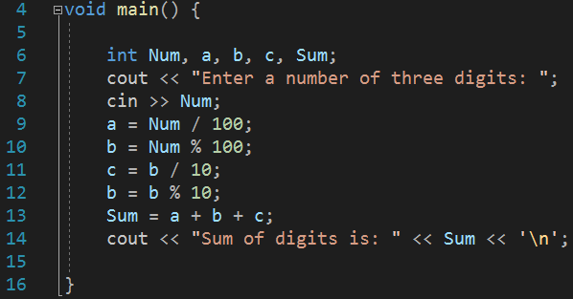
Division & modulus operators
Example: write a program that reads a three-digit integer number and prints the sum of each digit
a: 456 / 100 = 4
b: 456 % 100 = 56
c: 56 / 10 = 5
d: 56 % 10 = 6

Slide 13
Precedence & associativity of operators
An expression may have more than one operator and its precise meaning depends on the precedence and associativity of the involved operators
What is the value of variables a, b and c after the execution of the following statements
int a, b = 2, c = 1;
a = b+++c;
Which of the following interpretation is right?
a = (b++) + c;
or a = b + (++c);

Slide 14
Precedence & associativity of operators
Precedence: order of evaluation for different operators.
-Precedence determines how an expression like x R y S z should be evaluated (now R and S are different operators, e.g., x + y / z).
Associativity: order of evaluation for operators with the same precedence.
-Associativity means whether an expression like x R y R z (where R is a operator, e.g., x + y + z) should be evaluated `left-to-right' i.e. as (x R y) R z or
‘right-to-left' i.e. as x R (y R z);

Slide 15
Precedence & associativity of operators
Operator Precedence (high to low) | Associativity
:: | None
. -> [] | Left to right
() ++(postfix) --(postfix) | Left to right
+ - ++ (prefix) -- (prefix) | Right to left
* / % | Left to right
+ - | Left to right
= += -= *= /= etc. | Right to left
Example: a=b+++c
a=(b++)+c; or
a=b+(++c);
Example: int a, b=1;
a=b=3+1;

Slide 16
Operator | Description | Associativity
( ) [ ] . -> ++ -- | Parentheses (function call) (see Note 1) Brackets (array subscript) Member selection via object name Member selection via pointer Postfix increment/decrement (see Note 2) | left-to-right
++ -- + - ! ~ (type) * & sizeof | Prefix increment/decrement Unary plus/minus Logical negation/bitwise complement Cast (convert value to temporary value of type) Dereference Address (of operand) Determine size in bytes on this implementation | right-to-left
* / % | Multiplication/division/modulus | left-to-right
+ - | Addition/subtraction | left-to-right
<< >> | Bitwise shift left, Bitwise shift right | left-to-right
< <= > >= | Relational less than/less than or equal to Relational greater than/greater than or equal to | left-to-right

Slide 17
Note 1:
Parentheses “(” and “)” are also used to group sub-expressions to force a different precedence; such parenthetical expressions can be nested and are evaluated from inner to outer (e.g., a / ((b+c)*d)).
Note 2:
Postfix increment/decrement have high precedence, but the actual increment or decrement of the operand is delayed (to be accomplished sometime before the statement completes execution). So in the statement y = x * z++; the current value of z is used to evaluate the expression (i.e., z++ evaluates to z) and z only increments after all else is done.

Slide 18
Operator | Description | Associativity
== != | Relational is equal to/is not equal to | left-to-right
& | Bitwise AND | left-to-right
^ | Bitwise exclusive OR | left-to-right
| | Bitwise inclusive OR | left-to-right
&& | Logical AND | left-to-right
| | | Logical OR | left-to-right
? : | Ternary conditional | right-to-left
= += -= *= /= %= &= ^= |= <<= >>= | Assignment Addition/subtraction assignment Multiplication/division assignment Modulus/bitwise AND assignment Bitwise exclusive/inclusive OR assignment Bitwise shift left/right assignment | right-to-left
, | Comma (separate expressions) | left-to-right
e.g., int a,b;
a=b=b+1;
equal to a=(b=b+1);
equal to b=b+1; a=b;

Slide 19
Swapping the values
We want to swap the content of two variables, a and b.
What's wrong with the following program?
void main(){
int a=3, b=4;
a=b;
b=a;
}

Slide 20
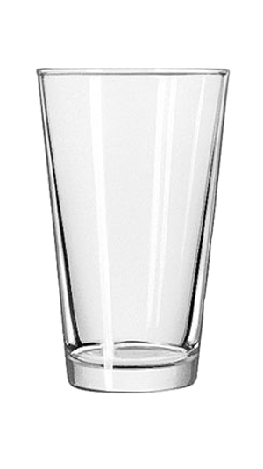
a=3
a=4
b=4
c
c=3
3
4

Slide 21
Swapping the values
We want to swap the content of two variables, a and b.
What's wrong with the following program?
void main(){
int a=3, b=4;
a=b;
b=a;
}
We need to make use of a temporary variable
c = a; /*save the old value of a*/
a = b; /*put the value of b into a*/
b = c; /*put old value of a (which is contained in c) to b*/

Slide 22
Efficient assignment operators
Generic form of efficient assignment operators
variable op= expression;
where op is an operator. The meaning is
variable = variable op (expression);
Popular efficient assignment operators include
+= -= *= /= %=
Examples:
a += 5; is same as a = a + 5;
a -= 5; is same as a = a - 5;
a += b*c; is same as a = a + (b*c);
a *= b+c; is same as a = a * (b+c);

Slide 23
Two’s Complement [Optional]
Two’s Complement represents signed integers (positive integers, 0, negative integers)
Designed to simplify the binary arithmetic, allowing the computer processor to perform all arithmetic operations using only addition
Based on the idea: y - x = y + (-x)
Two’s Complement
Positive integers are represented in the same way as sign-magnitude representation
0 is represented by setting all bits to 0
Negative integers are represented by bit patterns obtained by the following steps:
Convert the magnitude of the negative number in binary
‘Toggle’ each bit (0 → 1 and 1 → 0)
Add 1 to the binary number to get the resulting representation
Examples with 4-bit word size
+5₁₀ = 0101₂
0₁₀ = 0000₂
−5₁₀ = ?
Magnitude: +5₁₀ = 0101₂
Toggle: 1010₂
Add 1: 1010₂ +0001₂ =1011₂
∴ − 5₁₀ = 1011₂

Slide 24
Two’s Complement [Optional]
Conventional approach can be used to add binary numbers in two’s complement representation
Examples with 4-bit word size:
0 0 1 0 (+2₁₀)
+ 0 0 1 1 (+3₁₀)
0 1 0 1 (+5₁₀)
0 0 1 0 (+2₁₀)
+ 1 1 0 0 (-4₁₀)
1 1 1 0 (-2₁₀)
1 1 1 1 (-1₁₀)
+ 0 0 1 1 (+3₁₀)
1 0 0 1 0 (+2₁₀)
1 1 0 0 (-4₁₀)
+ 1 1 0 1 (-3₁₀)
1 1 0 0 1 (-7₁₀)
As the word size is 4-bit, we only keep the last 4 bits
as the result and ignore the extra bit

Slide 25
Basic I/O – Keyboard and Screen
A program can do little if it cannot take input and produce output
Most programs read user input from keyboard and secondary storage
After process the input data, result is commonly display on screen or write to storage (disk)

Slide 26
Basic I/O – cin and cout
C++ comes with an iostream package (library) for basic I/O.
cin and cout are objects defined in iostream for keyboard input and screen display, respectively
To read data from cin and write data to cout, we need to use input operator (>>) and output operator (<<)

Slide 27
cout: Output Operator (<<)
Preprogrammed for all standard C++ data types
It sends bytes to an output stream object, e.g. cout
Predefined “manipulators” can be used to change the default format of arguments

Slide 28

cout: Output Operator <<
Type | Expression | Output
Integer | cout << 21 | 21
Float | cout << 14.5 | 14.5
Character | cout << ‘a’; cout <<‘H’ << ‘i’ | a Hi
Bool | cout << true cout << false | 1 0
String | cout << “hello” | hello
New line (endl) | cout << ‘a’ << endl << ‘b’; | a b
Tab | cout << ‘a’ << ‘\t’ << ‘b’; | a b
Special characters | cout << ‘\”’ << “Hello” << ‘\”’ <<endl; | “Hello”
Expression | int x=1; cout << 3+4 +x; | 8

Slide 29
cout – Change the Width of Output
Change the width of output
Calling member function width(width) or using setw manipulator (which requires iomanip library: #include <iomanip>)
Leading blanks are added to any value fewer than the width
Effect last for one field only
If formatted output exceeds the width, the entire value prints
Approach | Example | Output (: space key)
1. cout.width(width) 2. setw(width) | cout.width(5);//or cout<<setw(5); cout << 123 << endl; cout << 123 << endl; cout.width(5); //or cout<<setw(5); cout <<1234567 << endl; | 123 123 1234567

Slide 30
cout – Set the format and precision of floating point Output
Floating-point precision is six by default, i.e. 5 decimal points
Use fixed, scientific and setprecision manipulators to change the printing format and precision value.
Must #include <iomanip>
Effect is permanent
Default behavior
Example | Output
cout << 1.34 << endl; cout << 1.340 << endl; cout << 1.3401234 << endl; cout << 0.0000000134 << endl; | 1.34 1.34 1.34012 1.34e-008

Slide 31
fixed and scientific manipulators
cout<<fixed: always uses the fixed point notation (6 significant digits after the decimal point)
cout<< scientific: always uses the scientific notation
They change the meaning of precision (see the example)
Example | Output
cout << fixed; cout << 1.34 << endl; cout << 1.340 << endl; cout << 0.0000000134 << endl; | 1.340000 1.340000 0.000000
cout << scientific; cout << 1.34 << endl; cout << 1.340 << endl; cout << 0.000000012345671 << endl; cout << 0.000000012345675 << endl; | 1.340000e+00 1.340000e+00 1.234567e-08 1.234568e-08

Slide 32
setprecision manipulator
Normally, setprecision(n) means output n significant digits
But with “fixed” or “scientific”, setprecision(n) means output n significant digits after the decimal point
Example | Output
cout << setprecision(2); cout << 1.34 <<endl; | 1.3
cout << 0.0000000134 << endl; | 1.3e-008
cout <<fixed; cout << 1.34 << endl; cout << 0.0000000134 << endl; cout << scientific << 0.0005 << endl; | 1.34 0.00 5.00e-004

Slide 33
cout – Other Manipulator
Manipulators | Example | Output
fill | cout << setfill(‘*’); cout << setw(10); cout << 5.6 << endl; cout << setw(10); cout <<57.68 << endl; | *******5.6 *****57.68
radix | cout << oct << 11 << endl; // octal cout << hex << 11 << endl; // hexidecimal cout << dec << 11 << endl; | 13 b 11
alignment | cout << setiosflags(ios::left); cout << setw(10); cout << 5.6 <<endl; | 5.6

Slide 34
cin: Input Operator (>>)
Preprogrammed for all standard C++ data types
Get bytes from an input stream object
Depend on white space to separate incoming data values

Slide 35
Input Operator
Type | Variable | Expression | Input | x | y
Integer | int x,y; | cin >> x; | 21 | 21
 |  | cin >> x >> y; | 5 3 | 5 | 3
Float | float x,y; | cin >> x; | 14.5 | 14.5
Character | char x,y; | cin >> x; | a | a
 |  | cin >> x >> y; | Hi | H | i
String | char x[20]; char y[20]; | cin >> x; | hello | hello
 |  | cin >> x >> y | Hello World | Hello | World

Slide 36
Programming styles
Programmers should write code that is understandable to other people as well
Meaningful variable names
Which is more meaningful
tax=temp1*temp2;
tax=price*tax_rate;
Meaningful comments
Write comments as you're writing the program
Indentations

Slide 37
Indentation styles
void main()
{
int x, y;
x = y++;
}
void main() {
int x, y;
x = y++;
}
Both are good. Choose one and stick with it.
void main()
{
int x, y;
x= y++;}
BAD!! Avoid this!!

Slide 38
Use of comments
Top of the program
Include information such as the name of organization, programmer’s name, date and purpose of program
What is achieved by the function, the meaning of the arguments and the return value of the function
Short comments should occur to the right of the statements when the effect of the statement is not obvious and you want to illuminate what the program is doing
Which one of the following comment is more meaningful?
tax = price * rate; // sales tax formula
tax = price * rate; // multiply price by rate

